Slide 1
AWS Course Introduction

Slide 2

About Me
Developer, Team Lead
Many Java Project, 1-2 AWS projects
Accounts: Thomson Reuters, Syngenta
10 years in Development, Support and Customer Face fronts

Slide 3
Required Tools and Instruments
Skype Group: https://join.skype.com/I70BFD0KrhvC
GitRepo: https://github.com/rusergei2010/AWSCourse2019
Register in AWS to gain access to Console: https://aws.amazon.com/console/
Home Tasks
Practice 2-3 tasks
Theory - Quiz

Slide 4




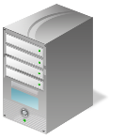
Cloud Computing Essentials
On-demand self-service
Broad network access
Resource pooling
Rapid elasticity
Measured service

Slide 5

Business Demand

Slide 6
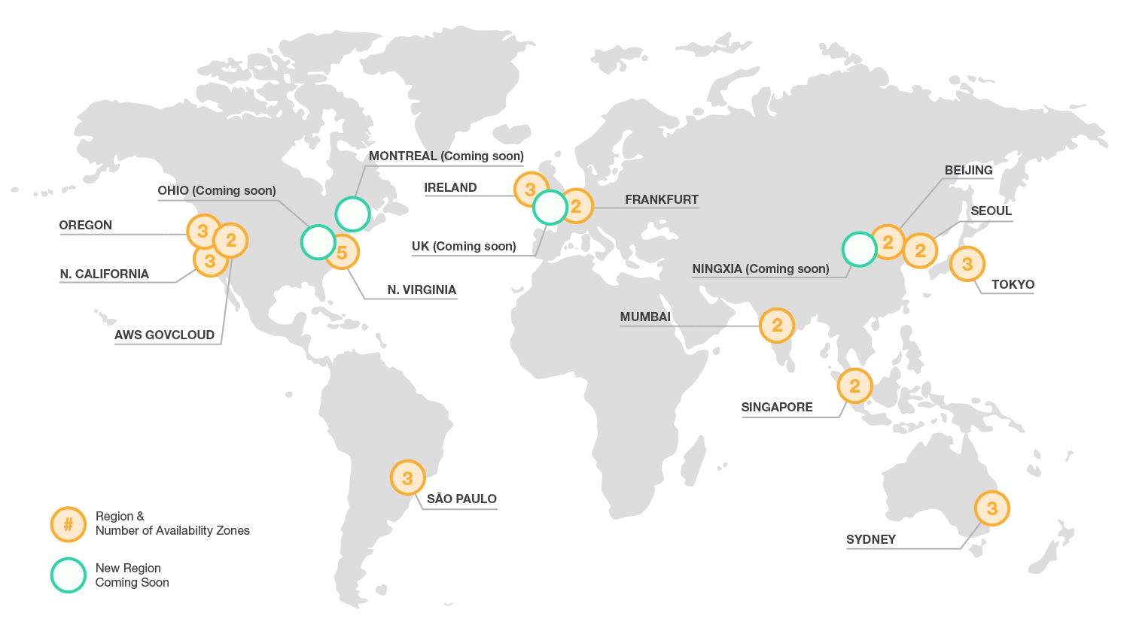
Global Infrastructure
https://aws.amazon.com/about-aws/global-infrastructure/

Slide 7
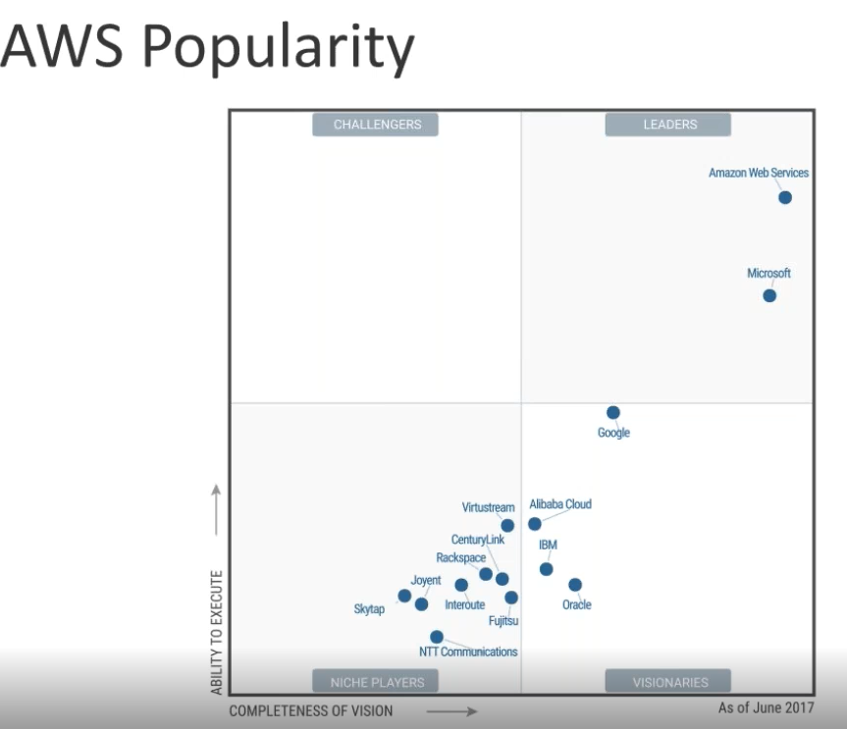
AWS vs Microsoft, Google
- AWS IAAS vs Microsoft and Google as PAAS
- Migration is easier to AWS from Data Center (Premise, infrastructure)
- Scalability
- Costs
- Time to Market (deployment)
- High Availability

Slide 8
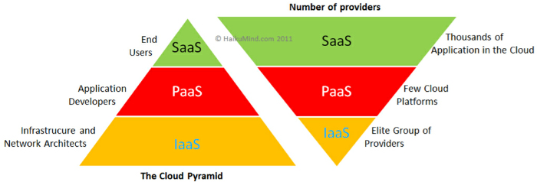
Cloud Computing types - SaaS (Office 365) - PaaS (OpenShift) - IaaS (AWS)

Slide 9
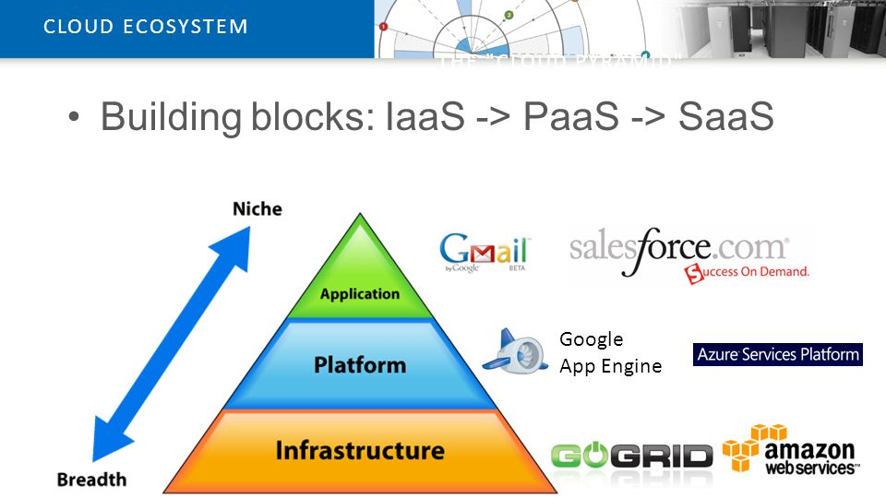
Vertical Structure of Cloud Computing platforms

Slide 10
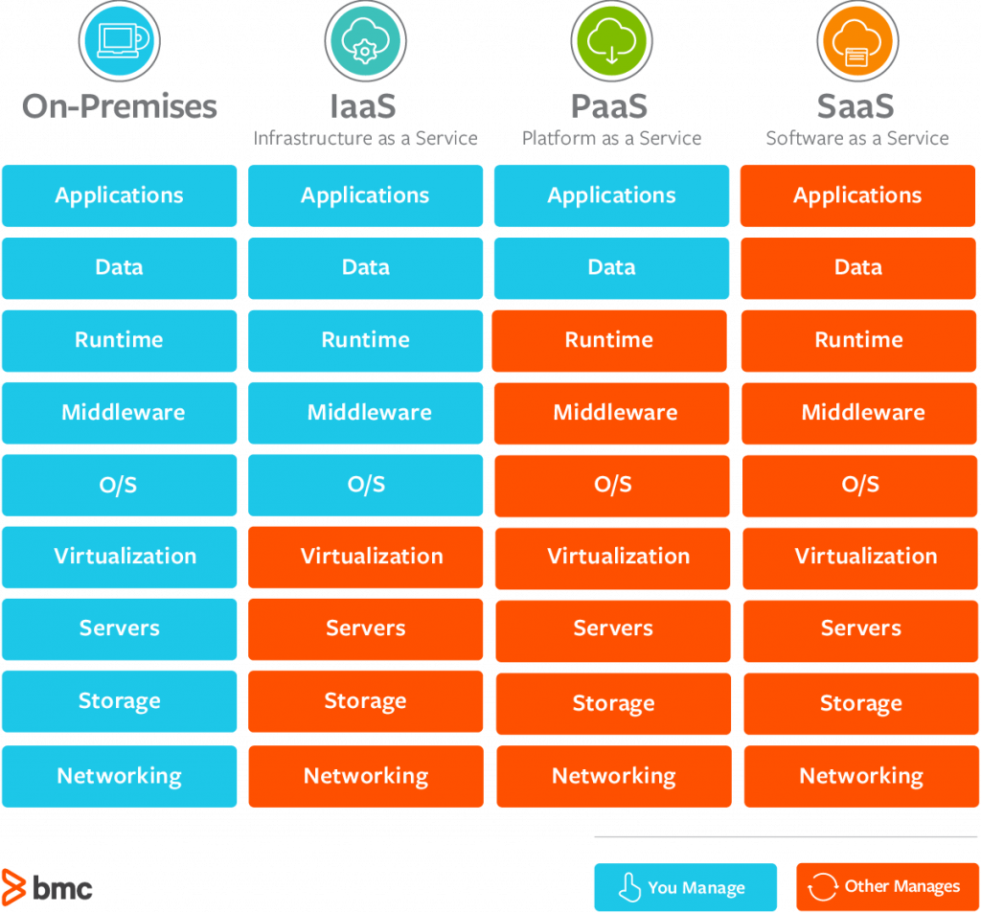
The Key Differences Between On-Premise, SaaS, PaaS, IaaS

Slide 11
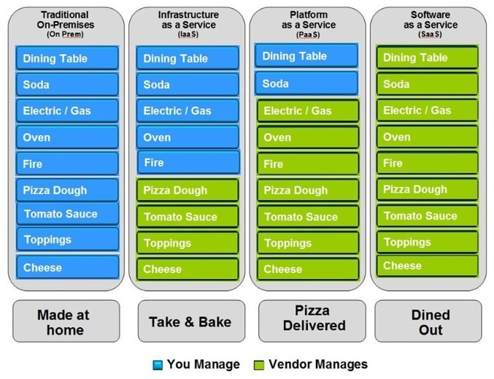
Pizza as a Service

Slide 12
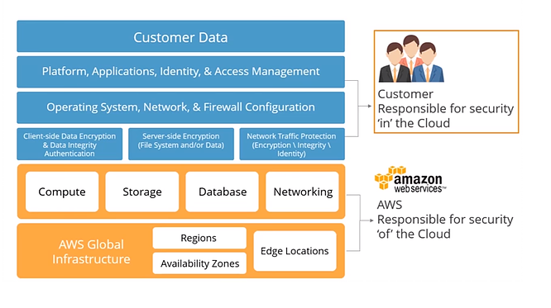
AWS shared responsibility model

Slide 13
Services to be discussed
EC2
Auto Scaling
CloudFormation
VPC
IAM (Identity and Access Management)
S3
DynamoDB
ElastiCache
RDS – relational database as a service
CloudWatch Metrics, Logs and etc.
ECS
Lambda, API GW

Slide 14
Tools and languages will be used
AWS Web Console
AWS CLI - https://docs.aws.amazon.com/cli/latest/userguide/install-windows.html
AWS SDK
OpenShift
CloudFormation
Troposphere
Python

Slide 15
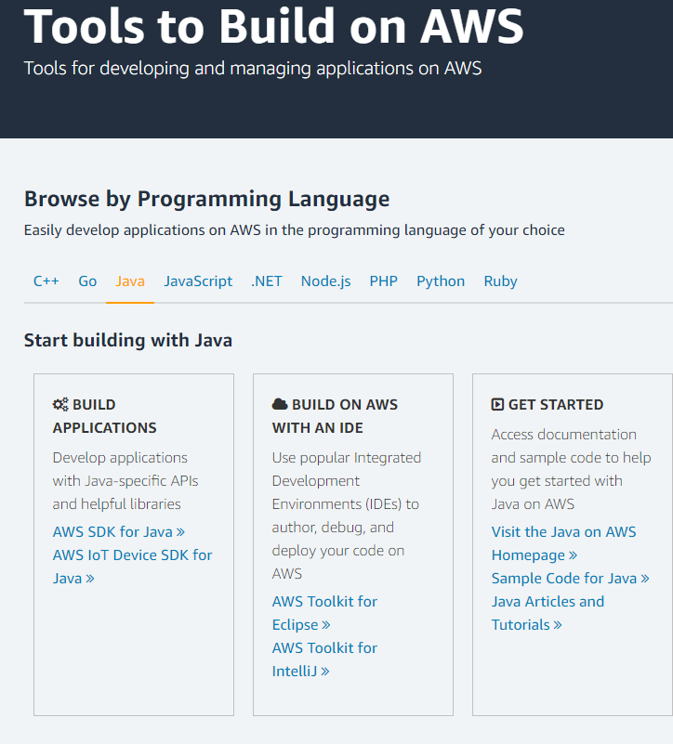
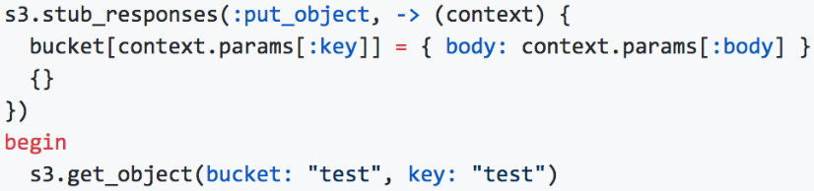
AWS SDK
https://aws.amazon.com/tools/

Slide 16
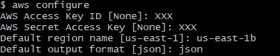
AWS CLI
AWS CLI https://docs.aws.amazon.com/cli/latest/userguide/install-windows.html
aws [options] <command> <subcommand> [parameters] Example:
$ aws s3 cp myvideo.mp4 s3://mybucket/
Credentials:
[default]
region = us-east-1
output = text
[profile epam_user]
region = us-east-1
output = json

Slide 17
Home Task
Join Skype Group: ‘AWS Course 2019’
Install AWS CLI
Register Free Tier Account in AWS

